Slide 1
SwiftCart – E-Commerce Sales Analytics | Excel Dashboard & Analysis
Presented By: Samudrala Praharshitha

Slide 2
Table of Contents
01 — Project Overview
02 — Data Preparation
03 — Sales & Customer Analysis
04 — Product, Channel & Regional Analysis
05 — Dashboard & Business Insights

Slide 3
01.Project Overview
SwiftCart is an e-commerce sales analysis project developed using Microsoft Excel.
The project analyzes:
Sales performance
Customer behavior
Product performance
Sales channels
Regional performance
Final Output: Excel Dashboard with supporting analysis.

Slide 4
Business Objective
• Analyze overall sales performance
• Identify top-performing products and categories
• Evaluate monthly sales trends
• Understand customer purchasing patterns
• Compare sales across different channels
• Analyze state and regional performance
• Examine B2B vs Non-B2B sales
• Support business decision-making
• Present findings through an Excel dashboard

Slide 5
Dataset Overview
Project: SwiftCart E-Commerce Sales
Tool Used: Microsoft Excel
Data Type: E-commerce transaction data
Records: 31048+ sales records
Customer Information: Customer ID, Gender, Age Group
Product Information: SKU, Category, Quantity
Sales Information: Amount, Channel, Order Status
Location Information: State and Region
Customer Segment: B2B / Non-B2B
Purpose: To transform raw sales data into meaningful business insights using Excel.

Slide 6
02.Data Cleaning & Preparation
• Checked missing values
• Checked and removed duplicate records
• Corrected data types
• Standardized category and status values
• Checked invalid and inconsistent data
• Prepared the dataset for Excel analysis
• Created required calculated fields
Clean Data → Accurate Analysis → Reliable Insights

Slide 7
Key Performance Indicators (KPIs)
• Total Sales – Overall revenue generated
• Total Quantity – Total number of products sold
• Total Orders – Number of orders analyzed
• Total Customers – Number of unique customers
• Average Order Value – Average sales value per record
• Delivered Orders – Successfully delivered orders
• Cancelled Orders – Cancelled orders
KPIs provide a quick view of overall business performance.

Slide 8
03 — Sales & Customer Analysis
Analyzed total sales generated from all transactions
• Calculated overall sales performance using Excel formulas
• Compared sales across categories, channels and regions
• Identified areas contributing the highest sales
• Used PivotTables to summarize sales performance
• Used charts to make sales patterns easier to understand
Key focus: Understanding the overall sales performance of SwiftCart.
Monthly Sales Trend
• Analyzed monthly sales performance
• Compared sales across different months
• Identified months with higher and lower sales
• Used a PivotTable to summarize monthly sales
• Created a line chart to visualize the sales trend
• Observed the overall sales movement over time
Key focus: Understanding how SwiftCart sales change month by month.

Slide 9
Customer Analysis
• Analyzed customer purchasing behavior
• Compared customers based on sales and quantity
• Identified high-value customers
• Studied customer contribution to overall sales
• Used PivotTables for customer-level analysis
• Used the analysis to understand customer value and sales concentration
Key focus: Identifying important customers and understanding their contribution to SwiftCart sales.
Gender & Age Group Analysis
Customer Demographics
• Analyzed sales based on gender
• Compared sales across different age groups
• Identified customer segments contributing to sales
• Used PivotTables for demographic analysis
• Created charts to compare gender and age-group performance
• Observed differences in purchasing patterns across customer segments
Key focus: Understanding customer demographics and their contribution to SwiftCart sales.

Slide 10
Order Status Analysis
• Analyzed different order statuses
• Compared the number of orders for each status
• Identified the distribution of successful and unsuccessful orders
• Used a PivotTable to summarize order status
• Created a chart to visualize the status distribution
• Used the results to understand order performance
Key focus: Understanding the overall order-status distribution in SwiftCart.

Slide 11
04 — Product, Channel & Regional Analysis
Category-wise Sales Analysis
• Analyzed sales performance across different product categories
• Compared total sales generated by each category
• Identified high-performing categories
• Used a PivotTable to summarize category sales
• Created a chart to compare category performance
• Studied category contribution to overall sales
Key focus: Understanding which product categories contribute most to SwiftCart sales.
Top 10 SKU / Product Analysis
• Analyzed sales performance of individual SKUs
• Identified the Top 10 products based on sales
• Compared sales contribution of the top-performing SKUs
• Used a PivotTable to rank products
• Created a chart to visualize Top 10 SKU performance
• Identified products with the highest sales contribution
Key focus: Understanding which individual products drive SwiftCart sales.

Slide 12
Channel-wise Sales Analysis
• Analyzed sales across different sales channels
• Compared total sales generated by each channel
• Identified high-performing channels
• Used a PivotTable to summarize channel sales
• Created a chart to compare channel performance
• Studied each channel’s contribution to overall sales
Key focus: Understanding which sales channels contribute most to SwiftCart revenue.
State-wise Sales Analysis
• Analyzed sales across different states
• Compared total sales by state
• Identified high-performing states
• Used a PivotTable to summarize state-wise sales
• Created a chart to compare state performance
• Studied the contribution of each state to overall sales
Key focus: Understanding the geographical distribution of SwiftCart sales.

Slide 13
Regional Performance
• Analyzed sales across different regions
• Compared total sales between regions
• Identified regions with higher sales performance
• Used Excel analysis to summarize regional sales
• Created a chart to compare regional performance
• Studied regional contribution to overall sales
Key focus: Understanding SwiftCart sales performance across different regions.
B2B vs Non-B2B Analysis
• Compared sales between B2B and Non-B2B customers
• Analyzed the total sales generated by each segment
• Identified the segment contributing more to overall sales
• Used a PivotTable for segment-wise comparison
• Created a chart to visualize B2B vs Non-B2B sales
• Studied the difference in customer segment performance
Key focus: Understanding sales contribution from B2B and Non-B2B customers.

Slide 14
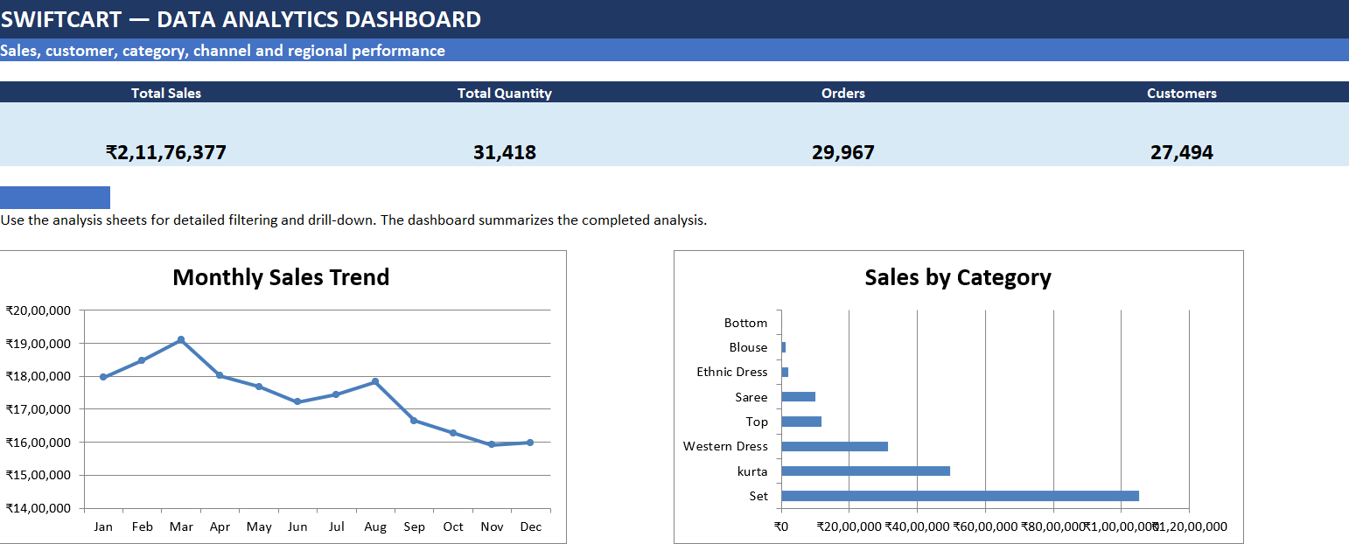
SwiftCart Dashboard

Slide 15
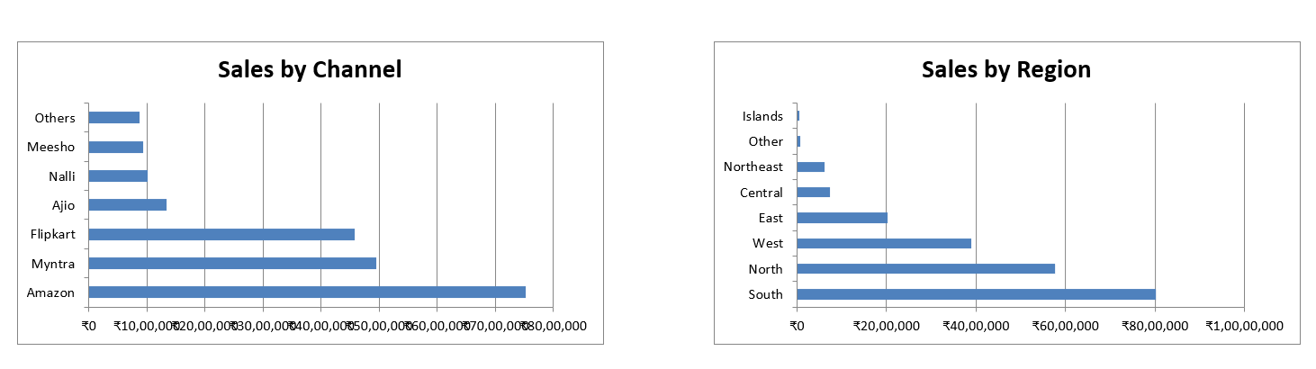
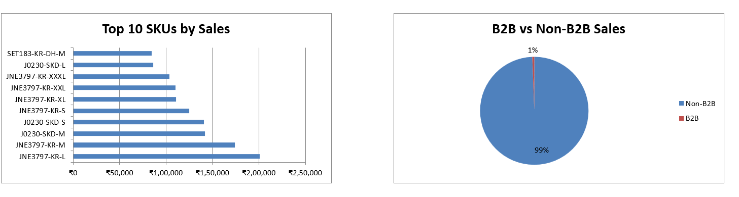

Slide 16
Dashboard Components
• KPI Cards – Quick view of key performance metrics
• Monthly Sales Chart – Shows sales movement over time
• Category Analysis – Compares category-wise sales
• Channel Analysis – Compares sales channels
• Regional Analysis – Shows geographical sales performance
• Top 10 SKU Chart – Highlights best-performing products
• B2B vs Non-B2B – Compares customer segments
Key focus: Bringing the major analysis results together for quick decision-making.

Slide 17
Key Business Insights
• Sales Performance: Overall sales performance was analyzed across the dataset
• Product Performance: Top categories and SKUs contribute significantly to sales
• Customer Performance: Customer-level analysis identifies high-value customers
• Channel Performance: Sales contribution varies across different channels
• Regional Performance: Sales differ across states and regions
• Customer Segments: B2B and Non-B2B segments show different sales contributions
• Sales Trend: Monthly analysis highlights changes in sales over time
Key focus: Converting Excel analysis into meaningful business insights.

Slide 18
Business Recommendations
• Focus on high-performing categories and products to maintain sales momentum
• Monitor monthly sales trends to identify changes in demand
• Strengthen channels that generate higher sales contribution
• Review regional performance and identify opportunities in lower-performing regions
• Build strategies to retain high-value customers
• Monitor B2B and Non-B2B segments separately
• Track order-status performance to reduce unsuccessful orders
Key focus: Use the analysis to support better sales, customer and operational decisions.

Slide 19
Project Summary & Deliverables
• Data Preparation – Cleaned and prepared the SwiftCart dataset
• Excel Analysis – Used formulas and calculations for analysis
• PivotTable Analysis – Analyzed sales, customers, products and regions
• Data Visualization – Created charts to identify important patterns
• Dashboard – Combined key KPIs and visuals into one view
• Business Insights – Identified important sales and customer patterns
• Recommendations – Suggested actions based on the analysis
Key focus: Complete end-to-end e-commerce data analysis using Microsoft Excel.

Slide 20
Conclusion
• SwiftCart data was successfully analyzed using Microsoft Excel
• The project covered sales, customers, products, channels and regions
• PivotTables and charts helped identify important patterns
• The Dashboard provides a clear summary of business performance
• The analysis supports data-driven business decisions
Raw Data → Excel Analysis → Dashboard → Business Insights

Slide 21
THANK YOU

